Slide 1
Firming Up Inequality
Jae Song
David Price
Fatih Guvenen
Nicholas Bloom
Till von Wachter
September 28, 2018
Individuals, Institutions, and Inequality Conference
OIGI , FRB Minneapolis
Notes:
Why matter:
Salience – more obvious if in the same firm
Opportunities and no salary effects – vary if only around other lower income employees
More generally suggests changes in the structure of the firm

Slide 2
This Paper:
What Role Do Firms Play in Rising Earnings Inequality?
How much of the rise in inequality is between firms?
  The large majority: 70% to 100% depending on measure
Are there are variations in this firm share in the data?
  Yes: between-firm “only” about 50-60% of variation for two groups:
    Mega firms (10k+ employees)
    The Top 0.5% (earnings above about $0.5m)
What explains rise in between firm inequality?
  ½ rising segregation + ½ sorting
  Changing “firm pay” differences contribute almost nothing.

Slide 3
Research builds on prior findings of an important role for firms in rising inequality
(US, 1977–1992, manufacturing) Between-establishment dispersion of earnings (Dunne, Foster & Haltiwanger 2004).
(US: 1992–2007, 9 states) Between-establishment inequality 2/3 rise in inequality (Barth, Bryson, Davis & Freeman 2014).
UK (1984–2001), Faggio, Salvanes and Van Reenen (2007), Mueller, Ouimet and Simintizi (2016)
Germany (1985–2009), Card, Henning and Kline (2013)
Brazil (1996–2012), Helpman, Itskhoki, Muendler and Redding (2015), Alvarez, Engbom and Moser (2017)
Sweden (1986–2008), Håkanson, Lindqvist & Vlachos (2015)
So whatever is driving this seems to be global
Notes:
Differences Barth et al.
Time period 36 years (1978-2013) vs 16 years (1992-2007)
All states vs 11 states (not these 11 states underweight on top 1% because omit North East States)
Establishments rather than firms, hence miss firm size driver and corporate head-quarters

Slide 4
Outline
The SSA database
Non-parametric results on inequality
  Basic result
  Mega firms (10K+ employees) vs the rest
  Robustness of the basic result
  Top 0.5%
More formal econometric approach (AKM and CHK)
Why is this happening - the changing structure of firms

Slide 5
Data: SSA Master Earnings File (MEF)
Universe of all W-2s from 1978 to 2013
For each job: SSN, EIN and total compensation:
“Total compensation includes: wages, salaries, tips, restricted stock grants, exercised stock options, severance payments, & all other types of income considered remuneration for labor services by the IRS.”
For each SSN: age, sex, place of birth, date of death
For each EIN: 4-digit SIC (industry) code, location
No top-coding, no survey response error, every firm & employee

Slide 6
Our core sample
Firms with 20+ employees (to get within firm inequality) and workers at those firms. Exclude government & education sector.
This sample covers 1.1m firms (18% of total), 103 million workers (73% of total) and $5.4tn in earnings (80% of total).
Results robust to including smaller firms weighted by size

Slide 7
Outline
The SSA database
Non-parametric results on inequality
  Basic result
  Firm size (Mega firms (≥10k employees) and the rest)
  Robustness of the basic result
  Top 0.5%
More formal econometric approach (AKM and CHK)
Why is this happening - the changing structure of firms

Slide 8
Income data is multi dimensional so various ways of showing a time trend in inequality
Decomposition of variance
Percentiles over time
Change by initial percentile
I will show each in turn, all with the same message that the majority of the increase in inequality is between firms
Notes:
Atkinson (1970), Dalton (1920)

Slide 9
Income data is multi dimensional so various ways of showing a time trend in inequality
Decomposition of variance
Percentiles over time
Change by initial percentile
I will show each in turn, all with the same message that the majority of the increase in inequality is between firms
Notes:
Atkinson (1970), Dalton (1920)

Slide 10
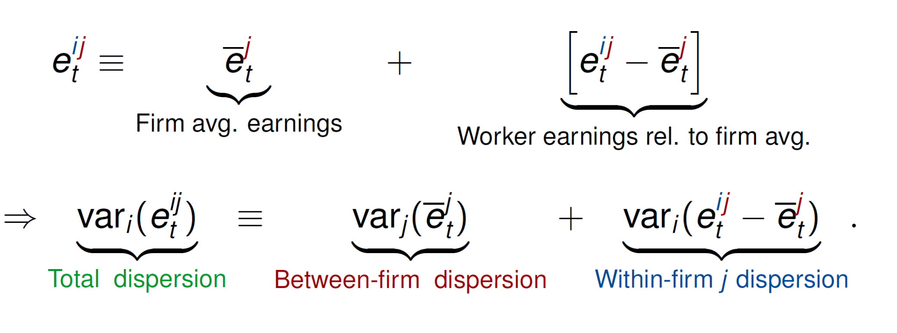
1. Decomposition of Variance

Slide 11
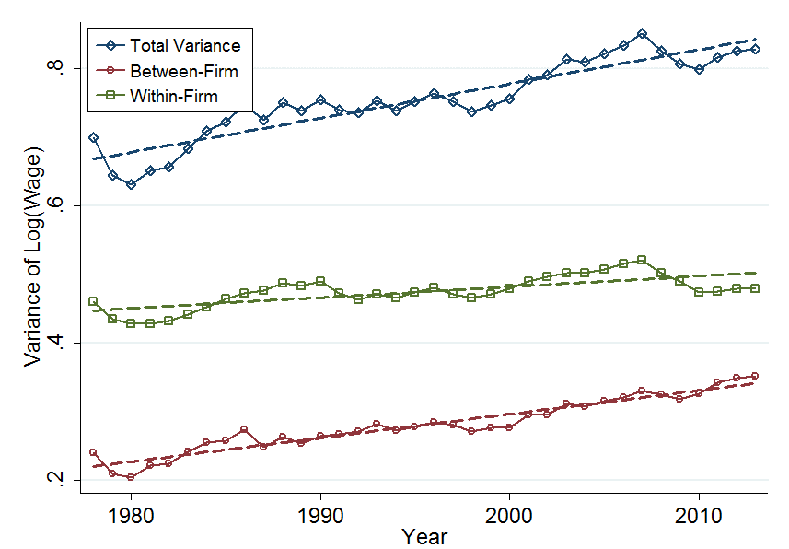
Decomposition of Variance – about 2/3 of increase is between firms
Notes:
Change in individual 1981-2013 is 19 log points, firms share is 14 log points (about 70%)

Slide 12
Outline
The SSA database
Non-parametric results on inequality
  Basic result
  Mega Firms (10K+ employees) vs the rest
  Robustness of the basic result
  Top 0.5%
More formal econometric approach (AKM and CHK)
Why is this happening - the changing structure of firms

Slide 13
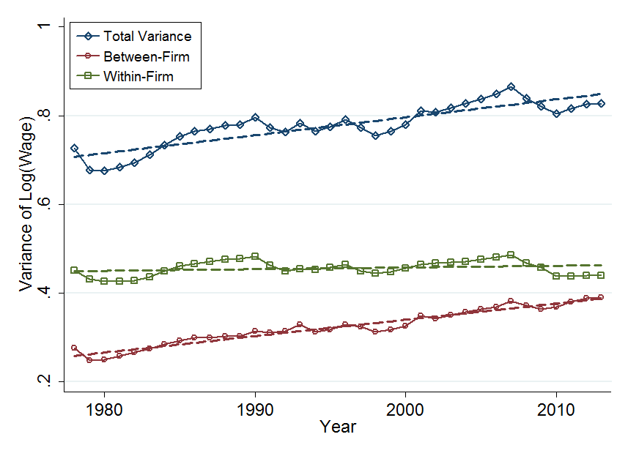
Decomposition of Variance: Firms with 20-10,000 Empl.
84% of the increase in inequality is between firms

Slide 14
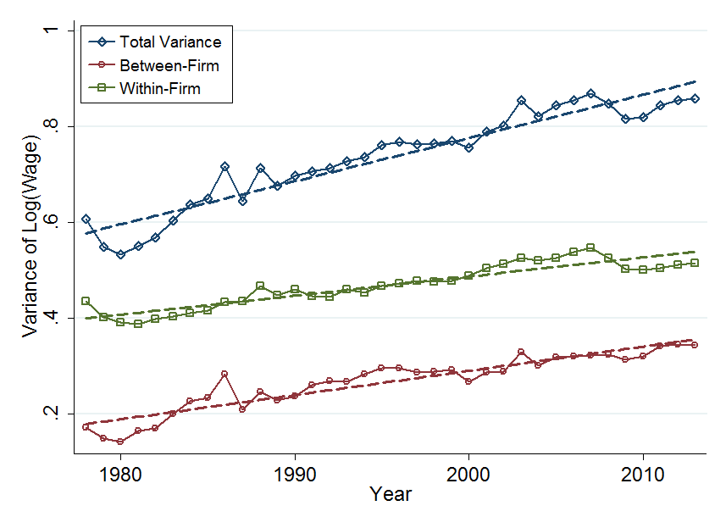
Decomposition of Variance: Mega Firms (10,000+ Empl.)
57% increase is between firms

Slide 15
Income data is multi dimensional so various ways of showing a time trend in inequality
Decomposition of variance
Percentiles over time
Change by initial percentile
I will show each in turn, all with the same message that the majority of the increase in inequality is between firms
Notes:
Atkinson (1970), Dalton (1920)

Slide 16
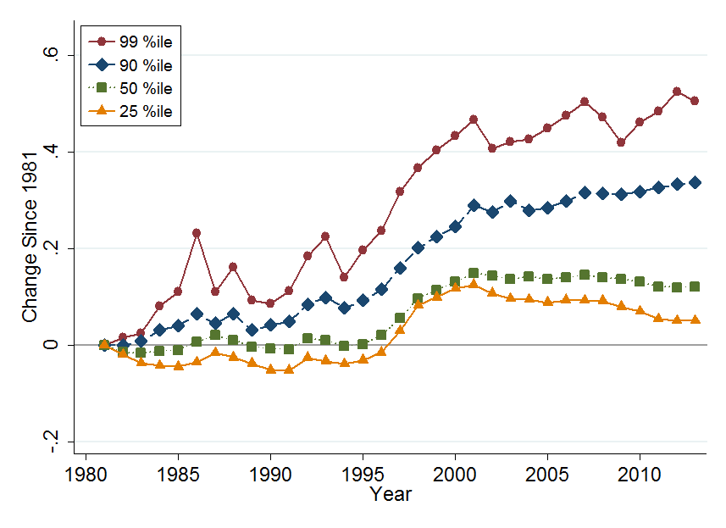
2. Percentiles over time: the classic inequality figure
Individuals
Note: Change in log real annual earnings by employee earnings percentile

Slide 17
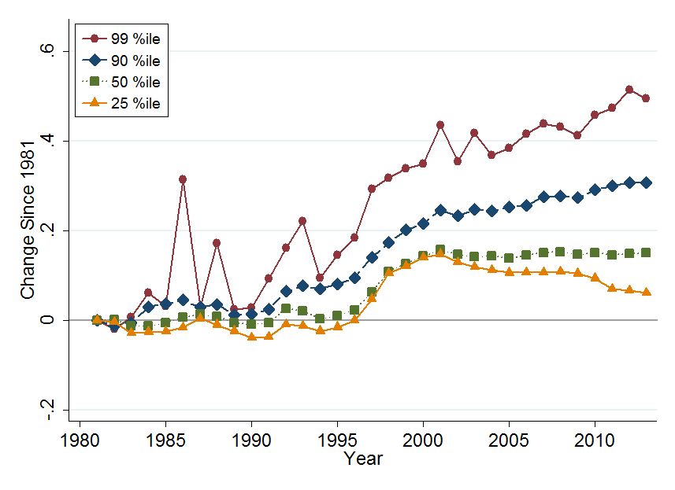
Now with average firm earnings for each individual
Their Firms
Note: Change in average log real annual firm earnings by employee’s earnings percentile

Slide 18
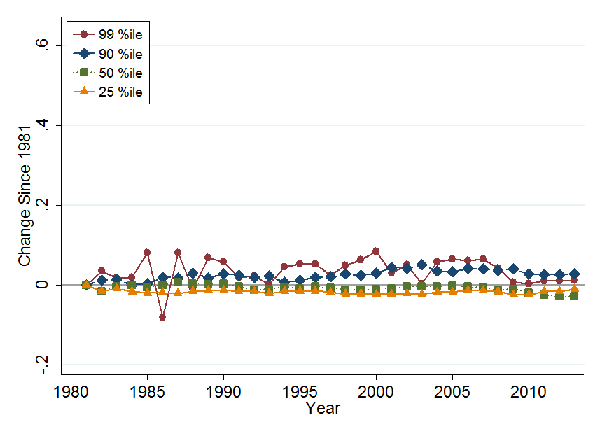
Now with individual/(average firm) earnings
Individuals/Their Firms
Note: Change (log employee – average firm) earnings by employee’s earnings percentile

Slide 19
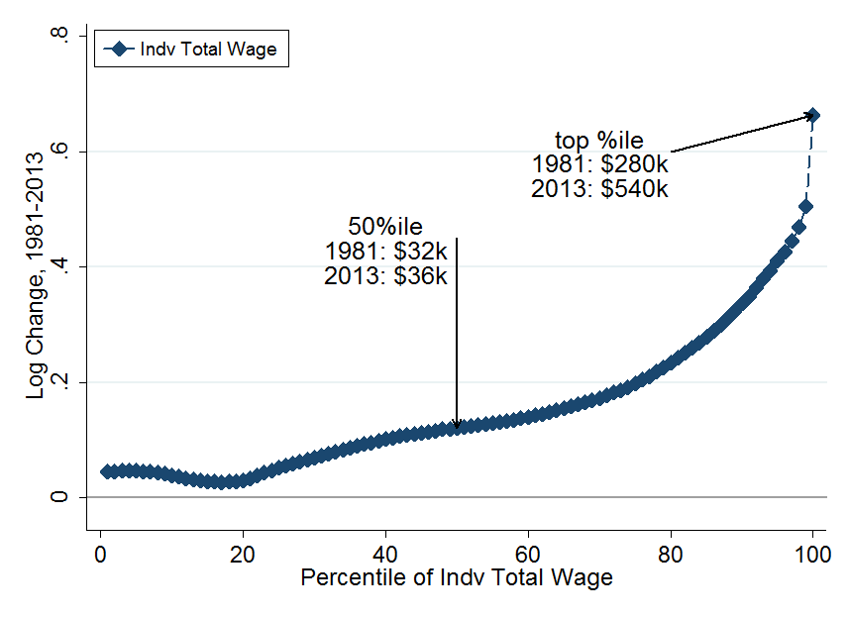
3. Changes in All Percentiles: 1981-2013
Note: Change in average log real annual pay for individuals in each percentile

Slide 20
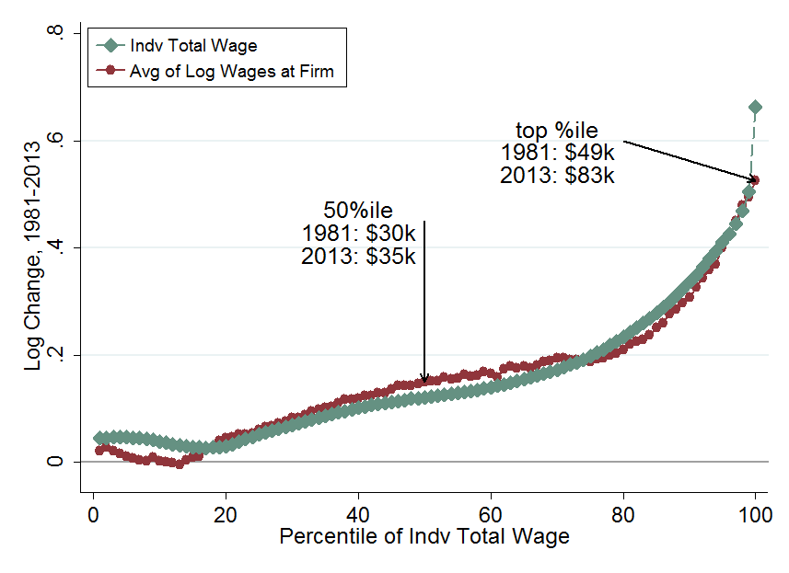
3. Changes in All Percentiles: 1981-2013
Note: Change in average log real pay for firms employing individuals in each percentile

Slide 21
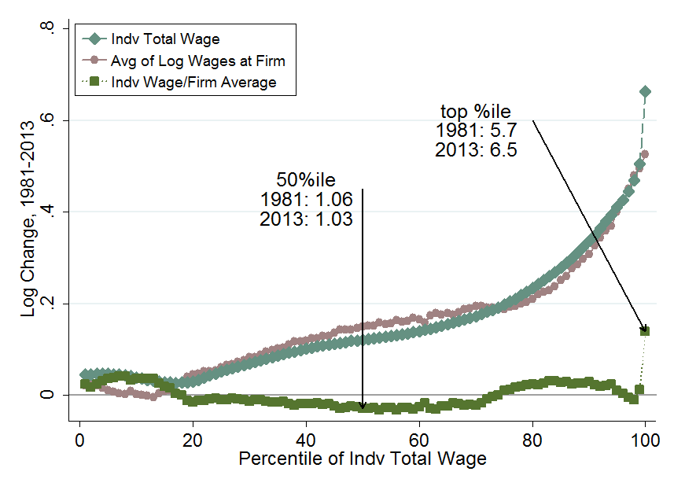
3. Changes in All Percentiles: 1981-2013

Slide 22
Robustness: different sub-groups look similar
Location (region and county)
Plants or firms (Census data)
Industry (SIC 1-digit and SIC 4-digit average)
Continuing firms
5-year earnings
Minimum earnings cutoff
Gender
Age

Slide 23
Outline
The SSA database
Non-parametric results on inequality
  Basic result
  Mega Firms (10K+ employees) vs the rest
  Robustness of the basic result
  Top 0.5%
More formal econometric approach (AKM and CHK)
Why is this happening - the changing structure of firms

Slide 24
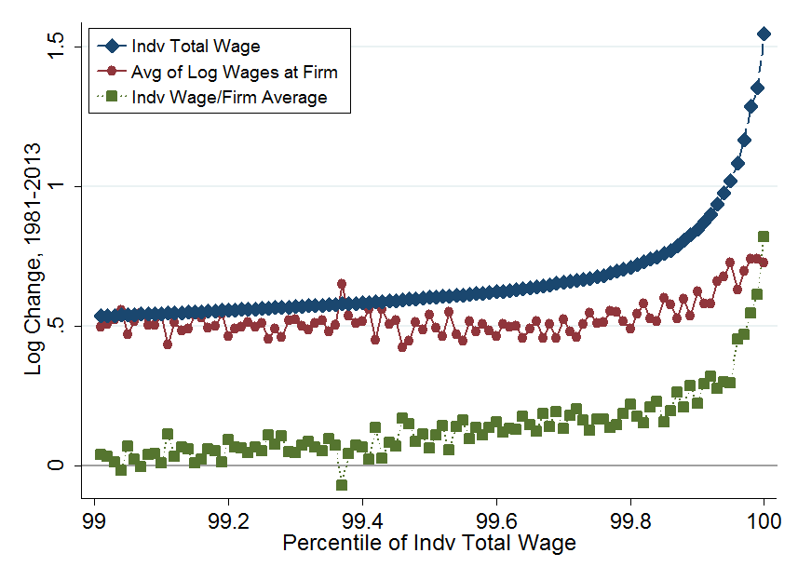
Zooming in on the top 0.5%
+370%
+125%
+110%

Slide 25
Outline
The SSA database
Non-parametric results on inequality
  Basic result
  Mega Firms (10K+ employees) vs the rest
  Robustness of the basic result
  Top 0.5%
More formal econometric approach (AKM and CHK)
Why is this happening - the changing structure of firms

Slide 26
Analysis with the Abowd, Kramarz and Margolis (1999) and Card, Henning and Kline (2013) Model
Statistical Model for Individual Log Annual Earnings
Fixed worker component α (e.g. education, innate ability, etc.)
Fixed firm component Ψ (e.g. rent sharing, efficiency wages, etc.)
Time varying worker characteristics X (here age and age squared)
Estimate Separately in 7-Year Intervals from 1980 to 2013
1980-1986 (first): 5.2m firms, 65m workers, 332m worker years
2007-2013 (last): 5.2m firms, 81m workers, 414m worker-year
Notes:
PSI

Slide 27
Identification of Model
Assumption of Conditional Random Mobility
Assume that conditional on worker & firm variables included in the model mobility between firms is random
Assessed Quality of Assumption (appears reasonable)
Mean gains & losses of movers between firm types symmetric?
  Yes: No indication that movers have systematic match component.
Systematic correlation of residuals by firm & worker effects?
  Not really: Few signs of systematic unexplained wage components
Is goodness of fit improved by worker-firm (i-j) match effects?
  Some: R² is ~78% in basic model. R² is ~85% with match effects

Slide 28
Decompositions of Variance in Earnings
Ignoring individual characteristics (X terms) we can write
where captures deviation pay from firm mean
Segregation
Sorting
Firm variance

Slide 29
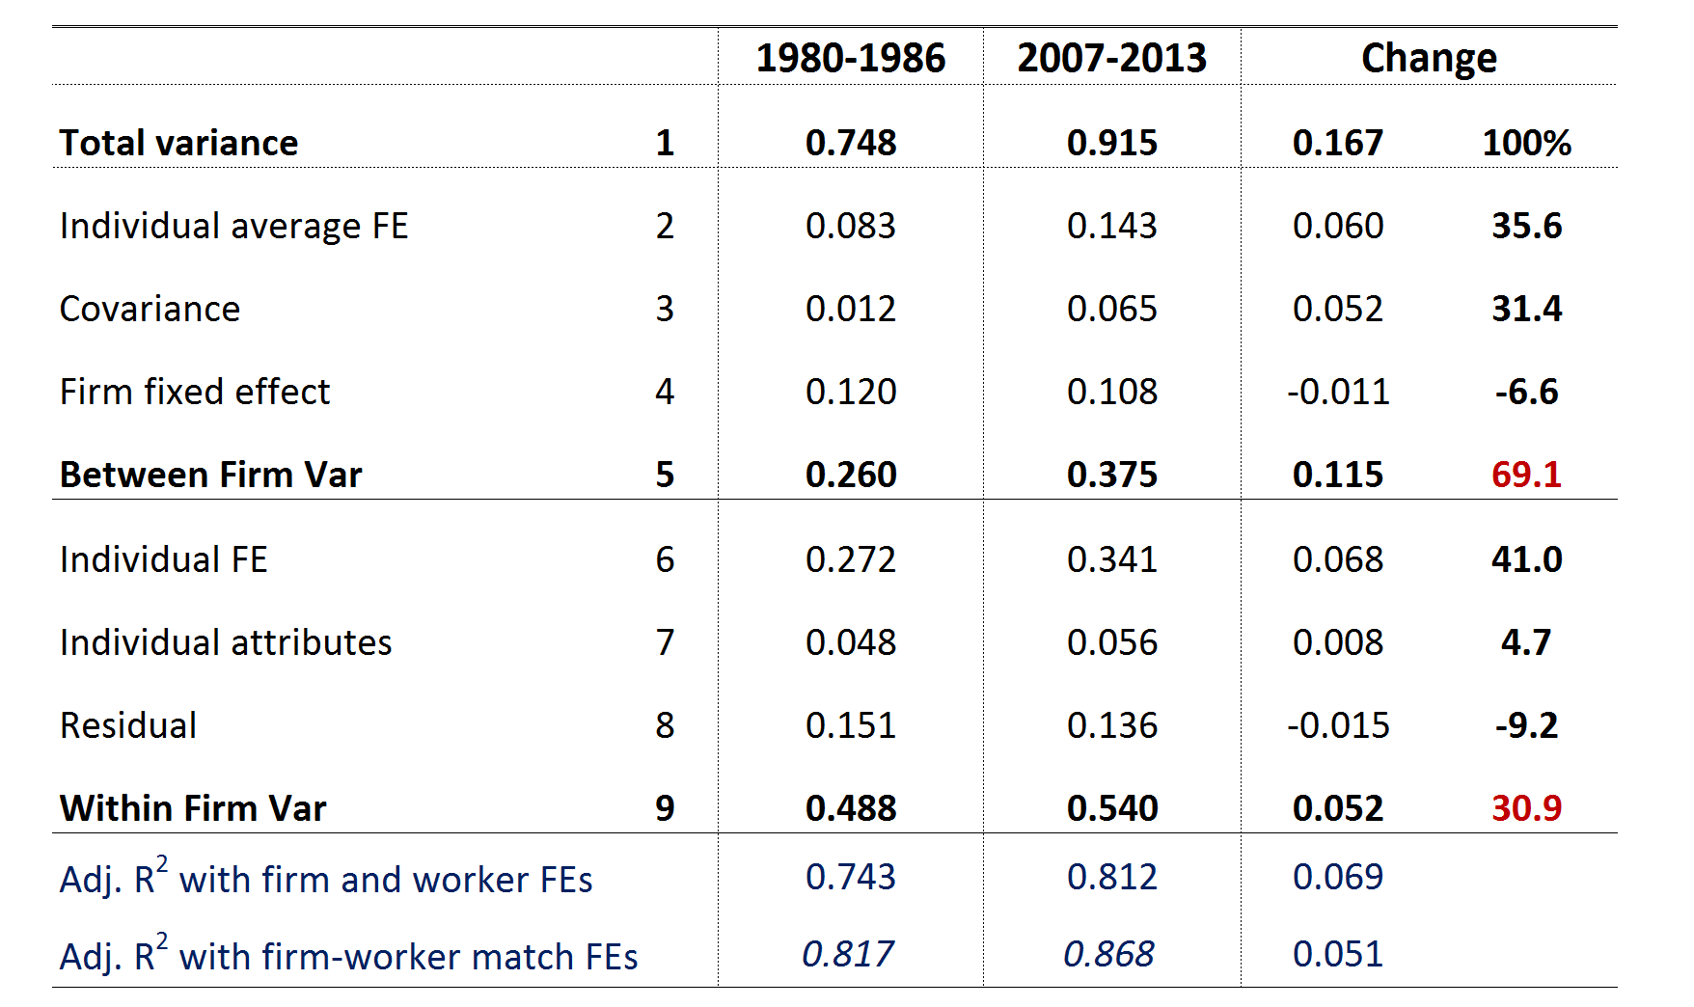
Results for changes in variance
This between-firm share is 87.6% in firms with <10K employees and 102.1% in firms with <1k employees
Note: Only the major terms are shown

Slide 30
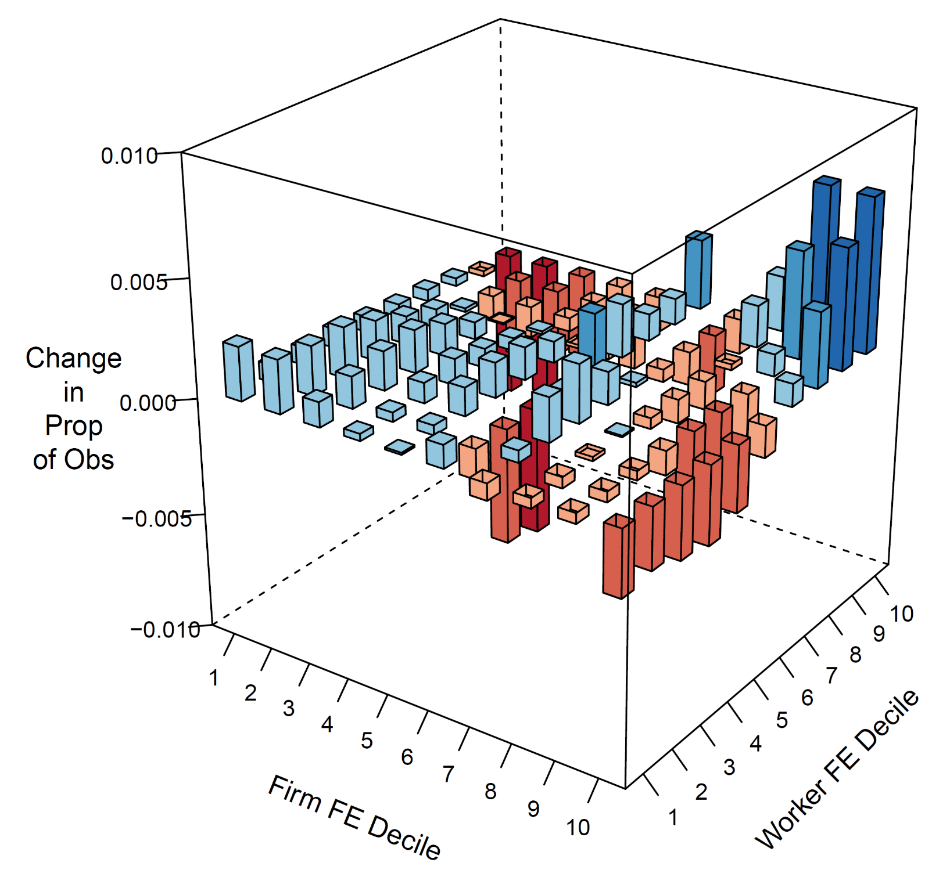

Rising sorting in graphics
Change in proportion of observations
(1980-1986 to 2007-2013)

Slide 31
Matches rising occupational, educational, skill and racial segregation in firms
Handwerker (2016) shows rising US occupational segregation in establishments (and EIN firms) since 2000.
See rising segregation in other measures and countries:
Card, Henning and Kline (2013): education and occupation
Barth, Bryson, Davis and Freedman (2014): education
Hakanson, Lindqvist & Vlachos (2015): cognitive skills
Ferguson and Koning (2017): racial segregation

Slide 32
Rising within-firm inequality has occurred almost entirely within Mega firms
What happened at:
the top end of within-firm earnings distribution? (CEOs, senior execs)
the bottom end of within-firm earnings distribution?

Slide 33
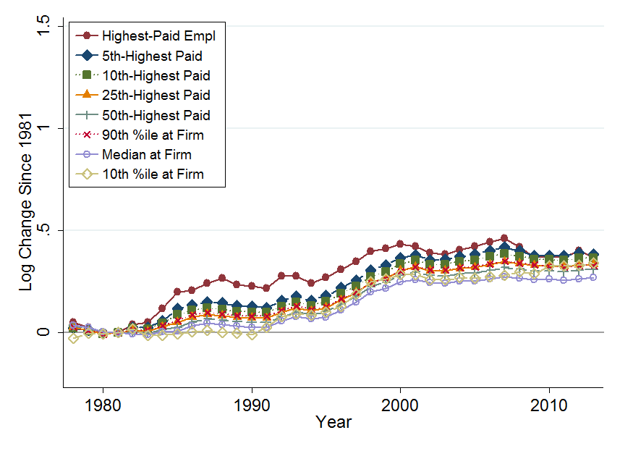
Top End: Firms 100 ≤ Empl.< 1K, Top Employee Earnings since 1981
+45%
+31%

Slide 34
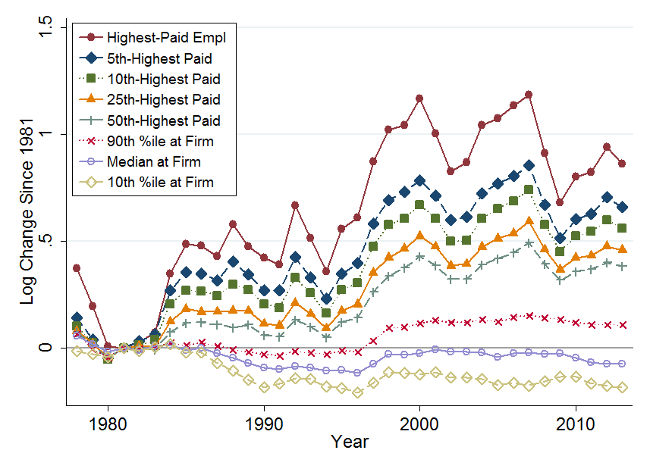
Top End: Mega Firms, Top Employee Earnings since 1981
+137%
+45%
-7%

Slide 35
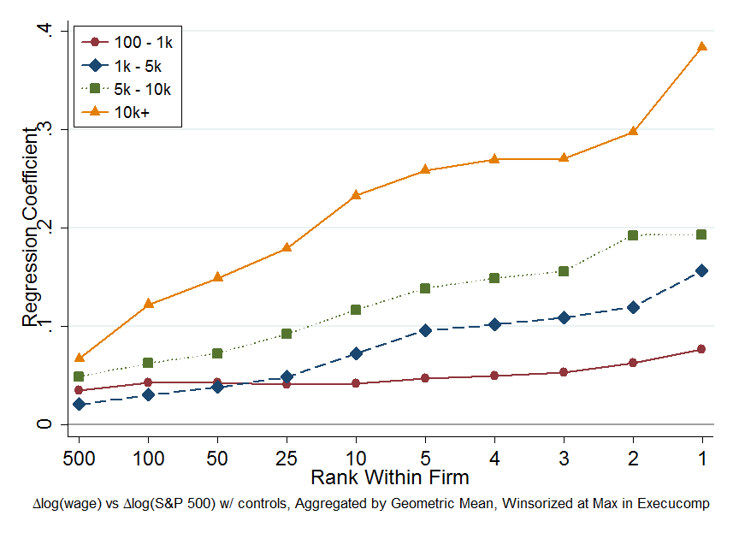
Top end: much of this likely stock grants & options
Notes:
Top-5 execs in Execucomp about 50% stock and options in 2014 and about 15% in 1993. Over 1981-1999 real returns on S&P500 has been 9.5%

Slide 36
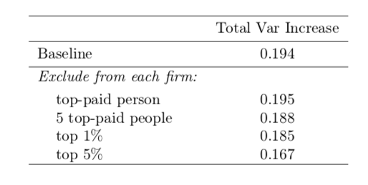
How Important is Rising CEO Pay for Rising Inequality?
For rise in overall inequality: No
For rise in within-group inequality: No
  Even in mega-firms, top 50 employees explain 3% of the rise in within-group inequality

Slide 37
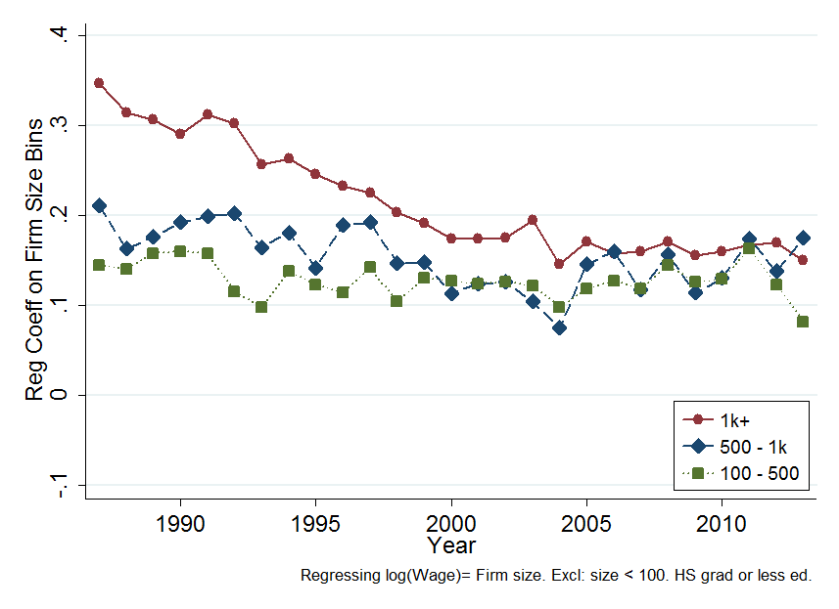
Bottom End: part of this appears to be low-skill wage premium in largest firms is vanishing
Source: CPS, which since 1987 includes firm size. Graph reports regression coefficients on firms size (<100 excluded category) with controls for industry, education, demographics and region.

Slide 38
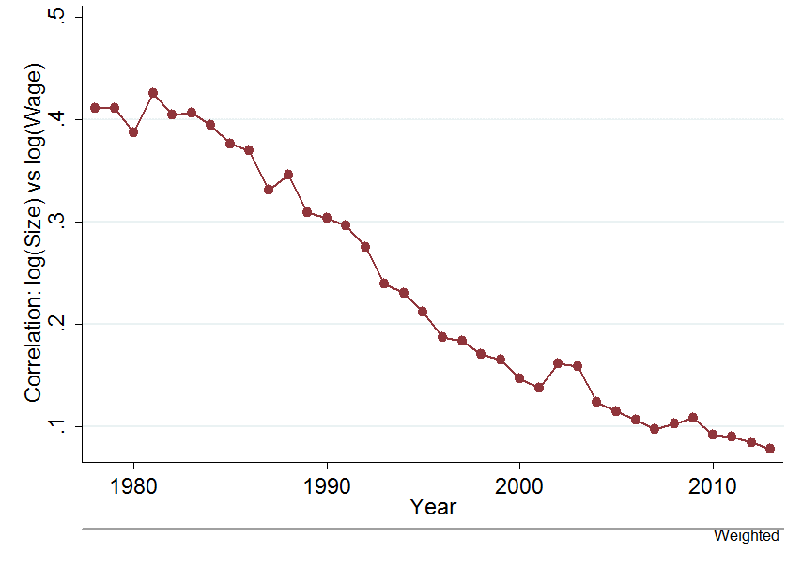
In short, the large-firm pay premium – present since 1900 (e.g. Moore 1911) is disappearing

Slide 39
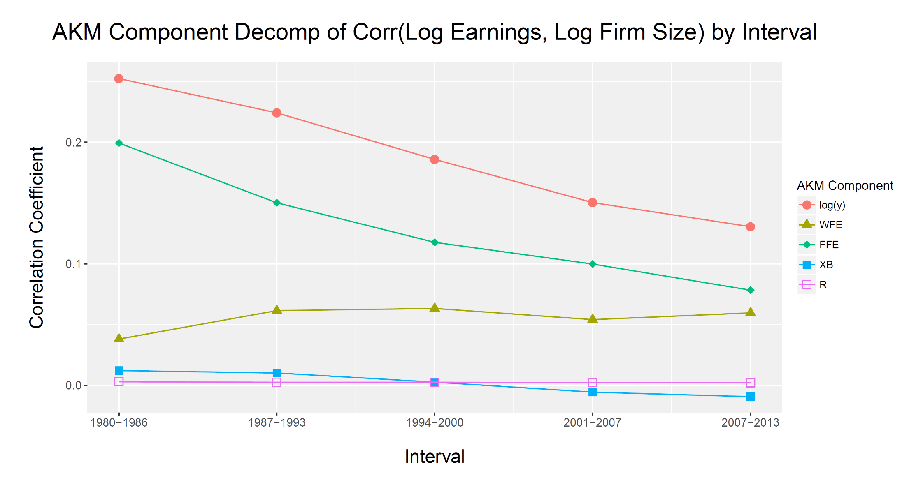
The disappearing large-firm wage premium seems comes from a falling large-firm AKM fixed-effect – in words, large-firms no longer pay “extra”

Slide 40
Conclusions
2/3 rising inequality across firms – segregation and sorting
1/3 rising inequality within (large) firms – rising C-suite pay, collapsing low-skill pay
Not clear why – exciting research questions around changes in:
  Firm organization (core competencies)
  Outsourcing
  Labor search (new technologies)
  Unions and minimum wages
  Healthcare and benefits
  “Fairness” concerns
Notes:
Head wages and hours division as the department of labor

Slide 41
BACK-UP

Slide 42
Zooming in on the top 0.5%
+370%
+125%
+110%

Slide 43
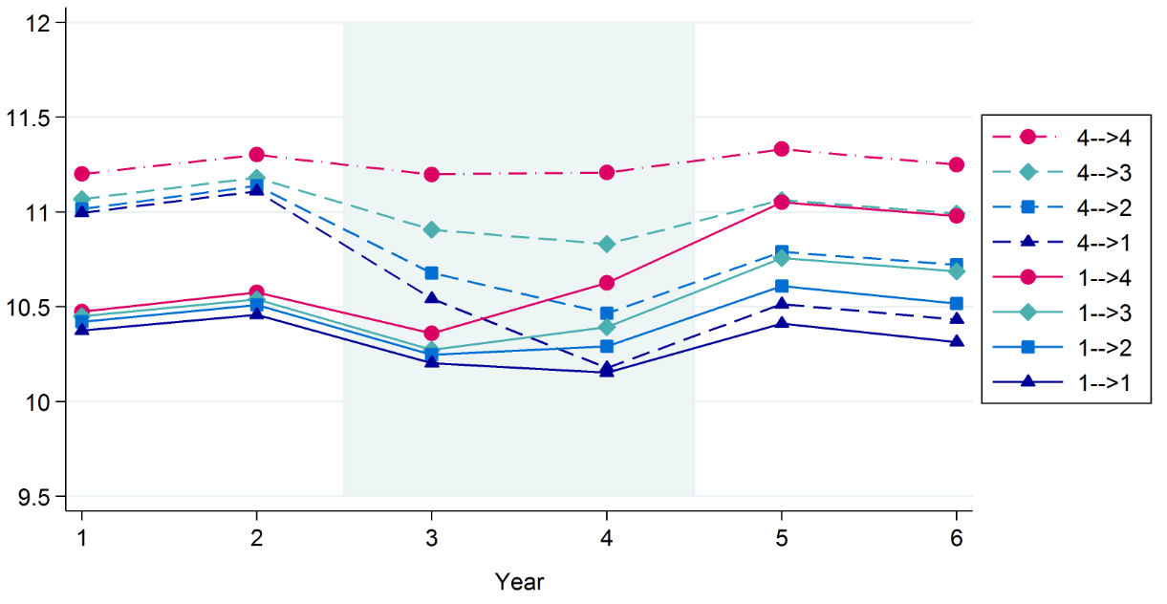
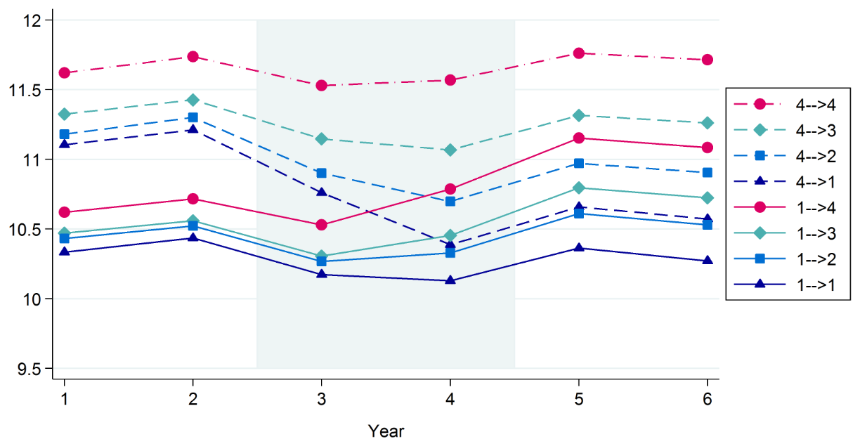
Wage Changes from Job Mobility: 1980-86 vs. 2007-13
1980-1986
Firms ranked by wages of coworkers
2007-2013
Detrended from year and age effects

Slide 44
Matches rising US occupational segregation
Notes: CPS, industry median occupational Herfindahl-Hirschman index at 3 digit occupation level, spliced across breaks in occupational coding classification

Slide 45
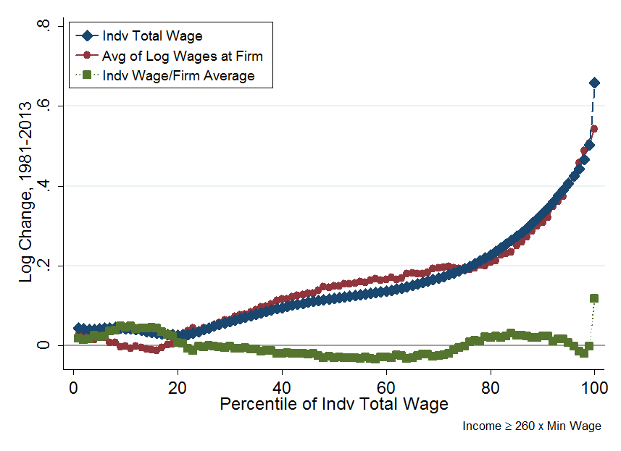
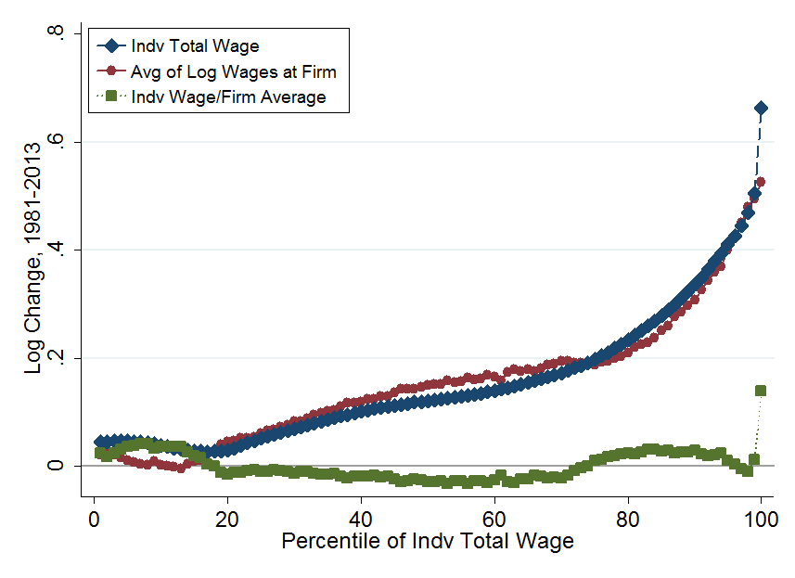
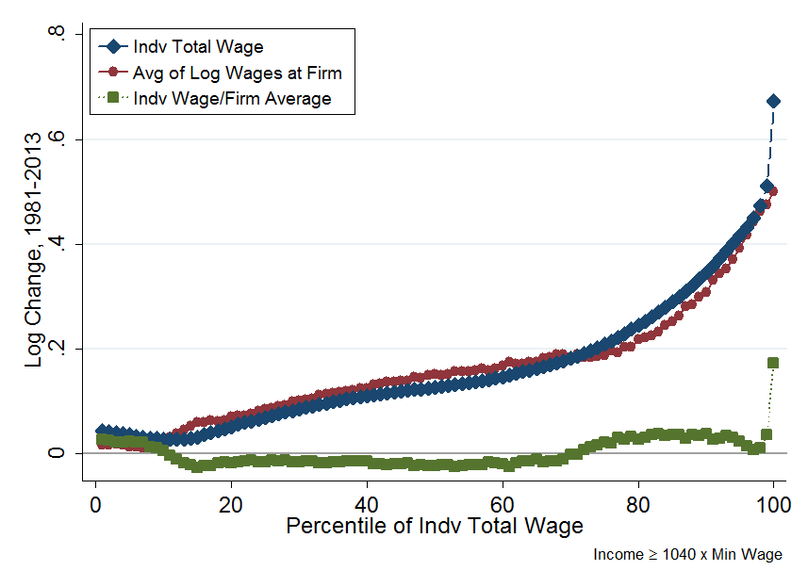
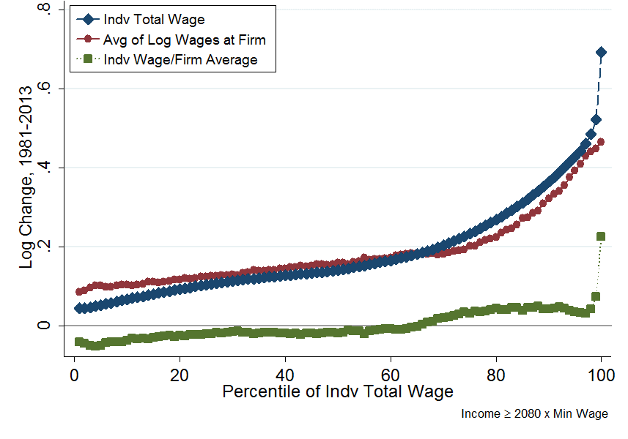
Similar for different minimum earnings cut-offs
6.5 Weeks ($2k)
13 Weeks ($4k)
26 Weeks ($8k)
52 Weeks ($15k)
Note: The figure shows the change in earnings for each percentile for individual (blue line with ♦ symbols), their firms (red line with ● symbols) and for individual relative to their firms (green line with ■ symbols). The data sample is all employees earning above the minimum wage full time for 6.5 weeks ($1,885 in 2013), 13 weeks ($3,770), 26 weeks ($7,540), and 52 weeks ($15,080), and all firms with 20+ employees. Firms in the government and educational sector have been dropped.

Slide 46
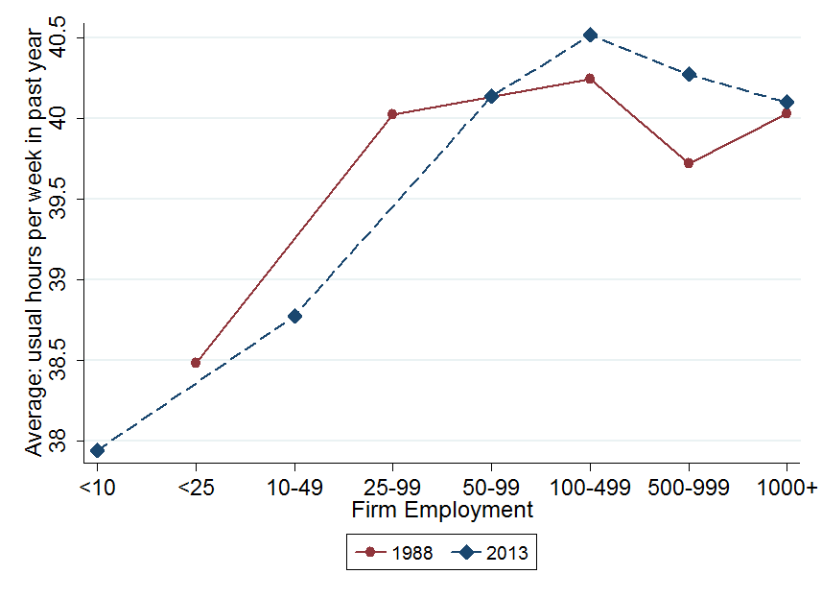
No evidence from CPS in shifting hours over time

Slide 47
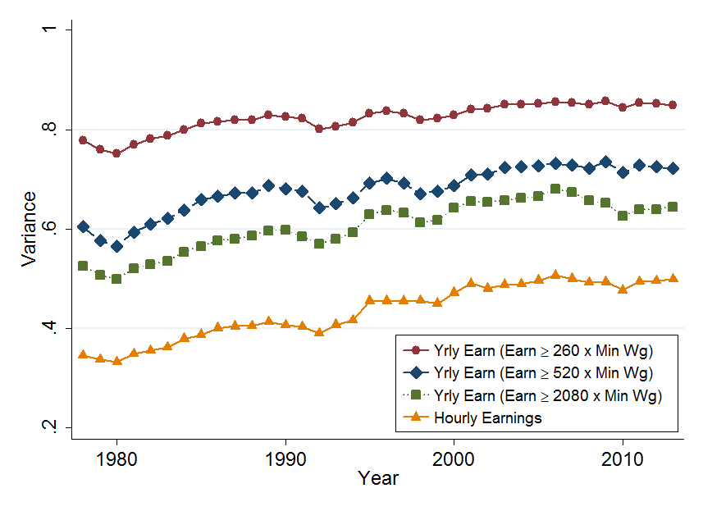
No evidence in CPS of offsetting hours changes

Slide 48
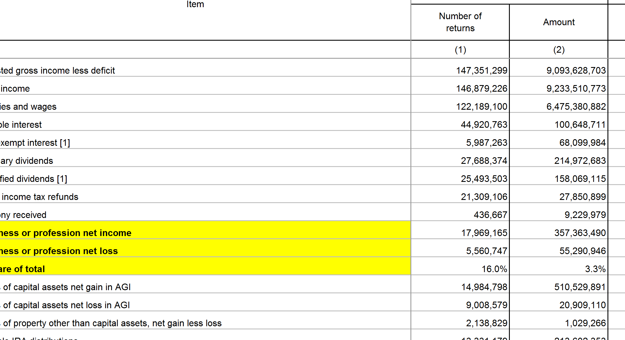
Self employment income – about 3.3% of total (all employees, probably less for those in 20+ person firms) but 16% of returns
IRS Statistics of income

Slide 49
Rising stock-option share of pay

Slide 50
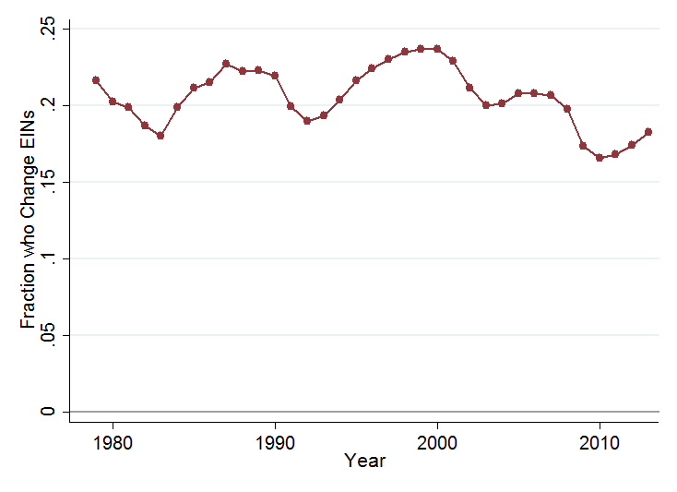
As job churn (SSN-EIN match change) is flat/falling, increased segregation from more targeted moves

Slide 51
Similar for plants & firms (Census LBD 1976-2011)
Change in the variance of the log wages since 1980: 10k+ employee firms
Across plants
Across firms
Across plants within firms
Source: Census LBD (all sectors excluding public and education), firms with 10,000+ employees. Results weighted by employment numbers at each plant
Notes:
Increase across plants is about 15 log points 1980-2011 and about 11 log points across firms – so even cross firms larger for large firms

Slide 52
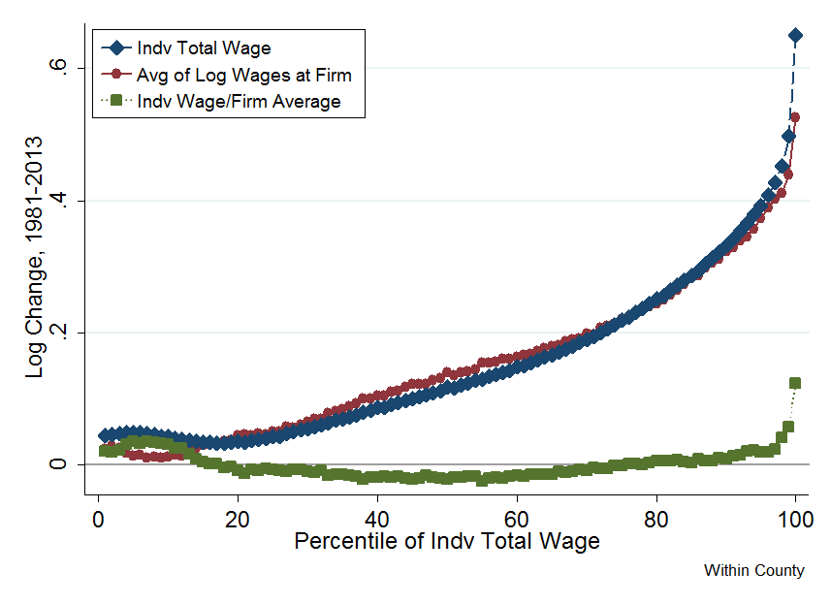
Within county (i.e. removing county average)

Slide 53
